Slide 1
PRESENTATION OF THE
FOUR-SQUARE GAME
SQUARE
4

Slide 2
Rules of the game:
1. It’s really your typical Tic-Tac-Toe game but with a slight twist.
2. It is a 2-player game which cannot be played without a friend
Both players’ first move may only be in one of the outer squares.
Thereafter players can use the whole board ☺
4. If either player has 3 X’s or O’s in a row, they have WON.
However, if none of the players have achieved this by the end of the game,
It is a DRAW

Slide 3
Demonstration of the game:
Player 1:
Player 2:
X
O
As depicted in the game rules:
Both Players may not make a move within the inner blocks if its their first move

Slide 4
Demonstration of the game:
Player 1:
Player 2:
X
O
PLAYER 1 WINS!
X
O
X

Slide 5
The Game interface looks like this

Slide 6
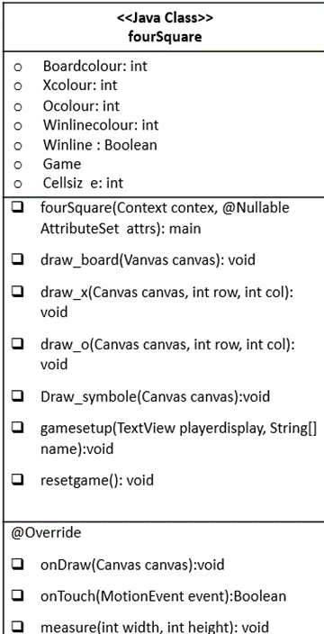
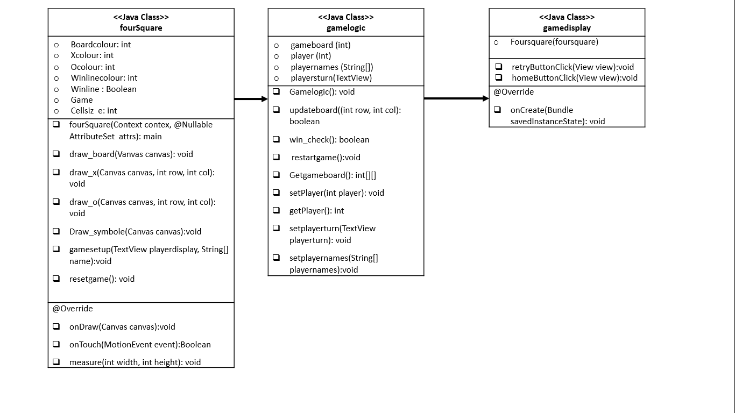
The Object Diagram( UML):

Slide 7
The Methods for the Game:
<<Java Class>> <<MainActivity>>
playbuttontap(View scr):void rulebuttontap(View scr):void
@Override onCreate(Bundle savedInstanceState):void
<<Java Class>> <<Game>>
MoveCnt: int GameBoard: Button[][] Move: String[][]
win_checker(): Boolean ResetButton(): void
@Override onCreate(Bundle savedInstanceState): void onClick(View v): void onClick(View scr): void

Slide 8
<<Java Class>> <<Name>>
@Override onCreate(Bundle savedInstanceState):void
<<Java Class>> <<Rules>>
@Override onCreate(Bundle savedInstanceState):void
<<Java Class>> <<Rules>>
@Override onCreate(Bundle savedInstanceState):void
<<Java Class>> <<Winner>>
@Override onCreate(Bundle savedInstanceState):void

Slide 9
The Classes for the Game:

Slide 10
GameDisplay class
Objects -> | Foursquare(foursquare)
Methods
@override onCreate(Bundle savedInstanceState): void
retryButtonClick(View view):void | Calls the reset game method to update the old array and updates the visuals of the board.
homeButtonClick(View view):void | It will take the user back to the home page every time

Slide 11
What we struggled with:
We attempted hardcoding the visual board drawing but without any experience, however we failed.
Thus we used buttons instead for the grid
Bringinig names across boards and changing the names on top was challenging
Getting the game to run on the emulator, as we did not have a private laptop/computer to use and
university computers did not allow us to install the HAXM extension needed to use the emulator
Uploading code to an already existing GitHub group and ended up having 5 different GitHub groups for
the code, that’s why it’s not visible that everyone contributed

Slide 12
This was our biggest Challenge:
Getting the game to run in the game to run in the end because we wrote the code for the game class
before coding each of the functionality buttons.
This was done in order for us to test if the game class was working throughout the duration of the project
This made very difficult to identify and/or track back any errors made in the written code.
After many trials and errors, we realised that we should’ve worked on the code for all the activities first,
and not coding the middle activity first with no way to test if it works properly.

Slide 13
Goals and Risks:
Goals:
To create an android game (Tic-Tac-Toe) with 4x4 blocks with the first 2 moves on the outer blocks
To actually finish the game in time, since we heard that no one managed to finish the game last year.
Risks encountered:
The uniqueness of our game is that it has 4x4 blocks instead of 3x3
We risked not being able to find a ways to code it in time
This variation also poses a threat as some phone screens may not be big enough to accommodate the game board

